Slide 1




HATE SPEECH DETECTION & ANALYSIS IN ONLINE HEALTHCARE COMMUNITIES
GROUP NO: 17
2023BCS0237 SIDHAARTH MOHANDAS
2023BCS0231 KUNAMALLA THARUN
2023BCD0066 VENKAT CHIRANJEEVI REDDY
2023BCS0039 GANGIREDDY VISHNU REDDY

Slide 2

INTRODUCTION
A 2020 JMIR Mental Health paper found that members of online depression forums who were exposed to highly negative, hopeless content showed worsened depression scores at 3-month follow-up compared to those in moderated, solution-focused communities.
Thus, Online Health Communities (OHCs) have become an important space where patients, caregivers, and healthcare professionals interact, share experiences, and seek support.
These platforms play a major role in spreading awareness and emotional support.
However, the presence of hate speech and toxic language is increasing, which negatively impacts the purpose of these communities and creates a stressful environment for users.

Slide 3


Hate speech is increasingly present in online health communities where patients seek help and share experiences. This creates a negative and unsafe communication environment.
Patients exposed to stigmatizing language
toxic or often feel
discouraged and may delay or completely avoid seeking medical treatment.
PROBLEM
Continuous exposure to harmful content reduces empathy among caregivers, bystanders, and community members, weakening the overall support system.
Healthcare discussions become dominated by negativity and fear, rather than recovery, positivity, and patient wellbeing.

Slide 4



The primary goal of this project is to develop a reliable system capable of automatically detecting and classifying hate speech in healthcare-related text data. This helps ensure safer and more respectful communication in digital health platforms.
GOAL
Another important goal is to analyze the impact of positive content on patient mindset. By promoting supportive language, the system aims to improve emotional well-being and encourage healthier interactions within online health communities.
Additionally, the project aims to enhance the quality of healthcare discussions by filtering harmful content and highlighting constructive communication. This contributes to building a more inclusive, safe, and supportive environment for patients and healthcare professionals.

Slide 5
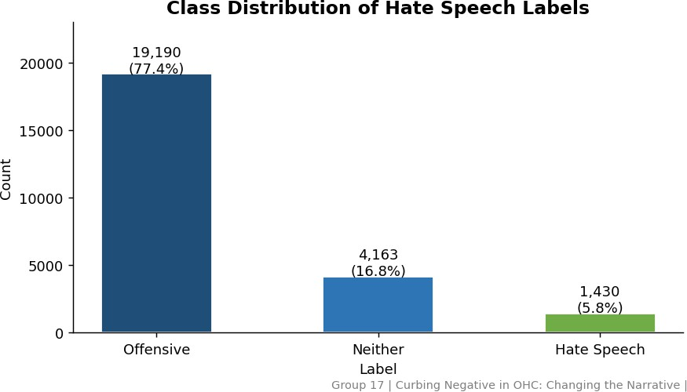
DATASET OVERVIEW
The project uses the Davidson Hate Speech dataset, which consists of approximately 24,783 labeled tweets. Each tweet is categorized as hate speech, offensive language, or neutral content.
This dataset is widely used in NLP research and provides a solid base for understanding patterns in toxic language.
The graph clearly shows that hate speech is a minority class, which creates a class imbalance problem that must be handled carefully during model training.

Slide 6
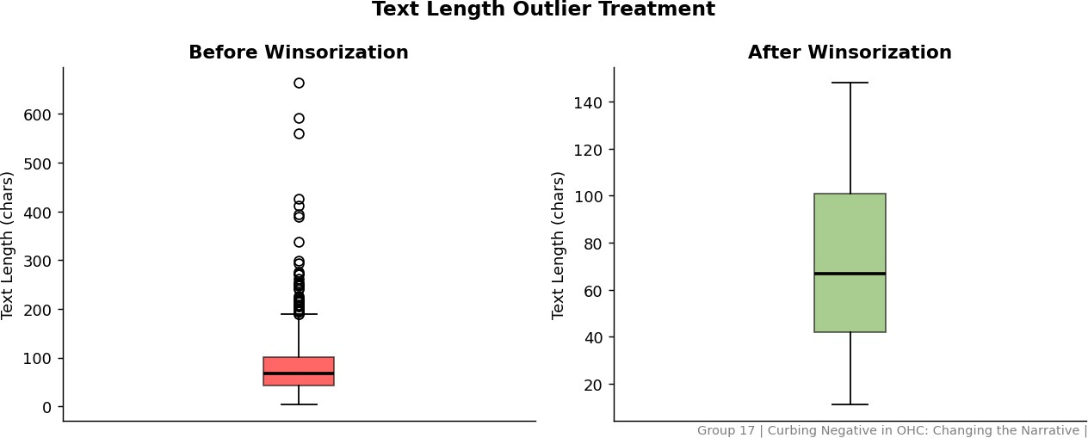
DATA PREPROCESSING
Before applying any models, the data is cleaned and prepared to ensure better accuracy. This includes removing unwanted elements such as URLs, special characters, and duplicate entries.
Outliers in text length are handled using winsorization, and the dataset is balanced using stratified sampling to ensure that all the classes are equally represented.
This step ensures that extreme values do not negatively affect model learning.

Slide 7

FEATURE ENGINEERING
To capture deeper insights from the text, several new features are engineered. SentimentScore helps identify emotional tone, while ToxicityDensity measures the proportion of toxic words.
CapitalizationRatio indicates aggressive writing patterns, and LexicalDiversity
reflects how varied the vocabulary is.
These features help the model understand not just words, but the behavior behind the text.

Slide 8
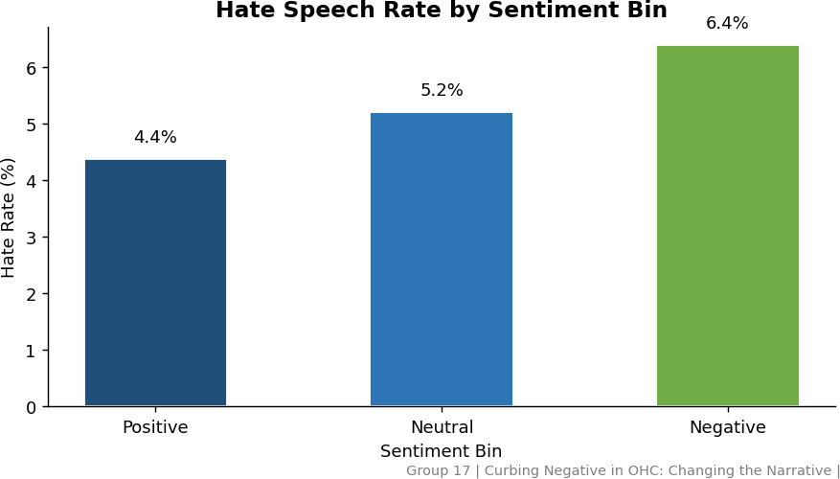
EXPLORATORY DATA ANALYSIS
Exploratory Data Analysis is performed to understand relationships between features and hate speech.
It is observed that posts with highly negative sentiment and high toxicity density have a much higher probability of being classified as hate speech.
These insights help in identifying important features that contribute to model performance.
This forms the foundation for feature engineering, where sentiment-based features are used to improve classification accuracy.

Slide 9

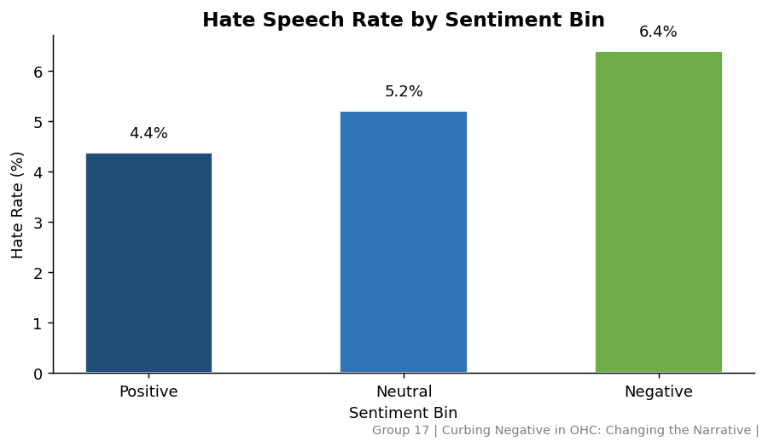
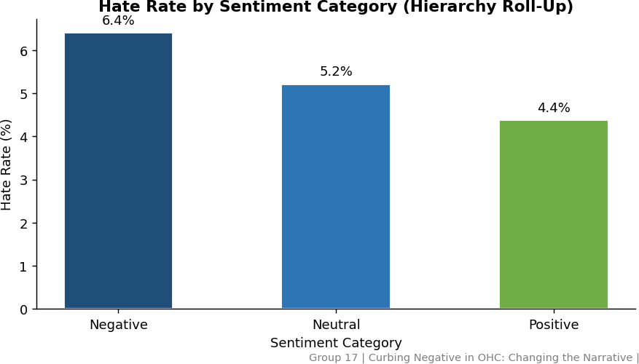
EXPLORATORY DATA ANALYSIS

Slide 10
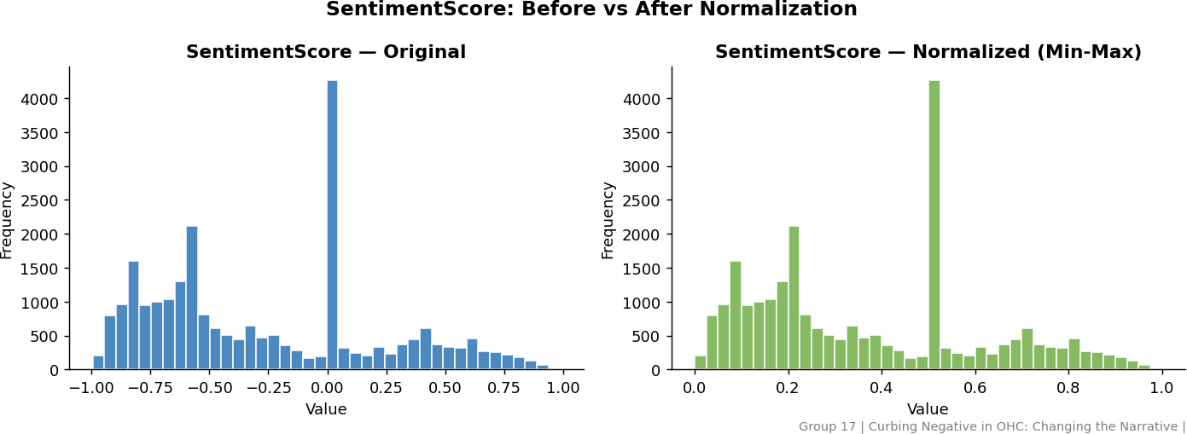
SENTIMENT DISTRIBUTION ANALYSIS
This analysis examines the distribution of sentiment scores across the dataset before and after normalization.
The original sentiment scores show a wide and uneven distribution, indicating variability in emotional intensity across tweets.
After applying normalization (Min-Max scaling), the values are transformed into a consistent range, making the data more suitable for machine learning models.
Normalization helps in improving model performance by ensuring that no single feature dominates due to scale differences.
This step is important for achieving stable and accurate classification results.

Slide 11
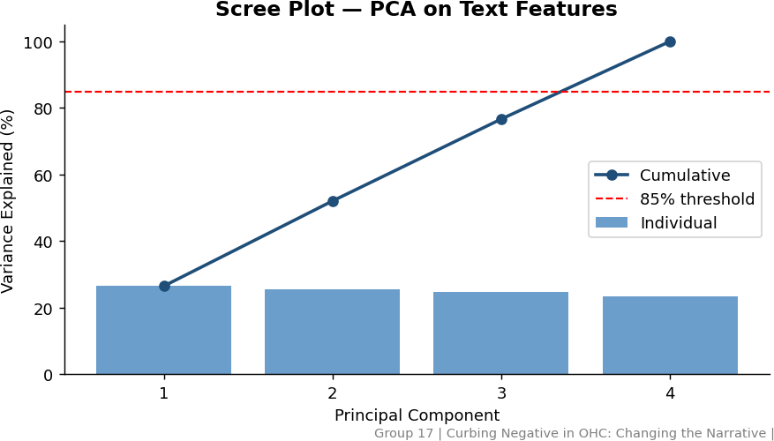
PCA (DIMENSIONALITY REDUCTION)
Principal Component Analysis (PCA) is applied to reduce the dimensionality of the dataset while retaining most of the important information.
By converting multiple correlated features into a smaller set of components, the model becomes more efficient and less complex.

Slide 12
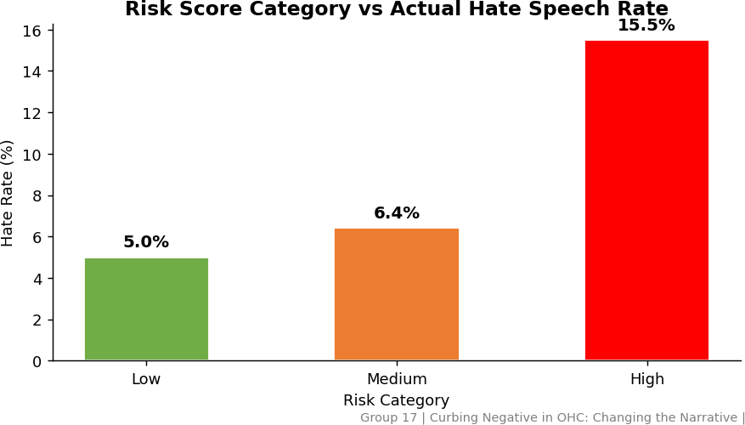
RISK SCORE MODEL
A composite risk scoring system is developed by combining multiple features such as sentiment, toxicity, and text patterns.
Each post is assigned a score and classified into low, medium, or high risk categories. This helps in quickly identifying highly toxic content before applying complex models.
The results show that high-risk posts are nearly 20 times more likely to be hate speech, making this approach very effective for pre- filtering.

Slide 13


MODELS
The project follows a progressive modeling approach, starting from simple models to more advanced deep learning techniques.
Logistic Regression is used as a baseline model because it is fast, interpretable, and provides a good starting point for comparison.
BERT is then applied as a transformer-based model that understands the context of words in a sentence, improving classification accuracy.
Finally, BioBERT is used, which is pre-trained on biomedical and healthcare-related text, making it more suitable for analyzing content from online health communities.

Slide 14
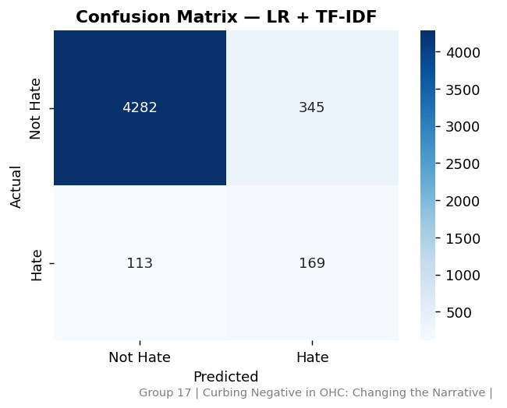
MODEL EVALUATION
The performance of the models is evaluated using standard classification metrics such as precision, recall, F1- score, and AUC-ROC.
Precision measures how many predicted hate speech instances are actually correct, while recall measures how many actual hate speech instances are successfully detected.
F1-score provides a balance between precision and recall, and AUC-ROC evaluates the model’s ability to distinguish between classes across different thresholds.

Slide 15
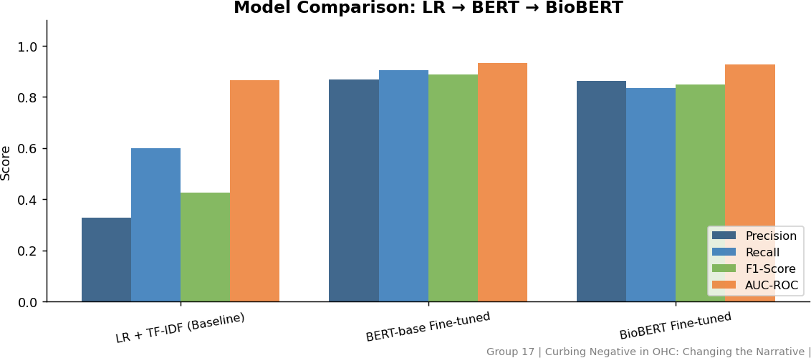
RESULTS & COMPARISON
The results show a clear improvement as we move from traditional machine learning models to advanced deep learning models.
Logistic Regression provides a solid baseline, but it lacks deep contextual understanding.
BERT improves performance by capturing word relationships and sentence context, while BioBERT achieves the highest accuracy due to its training on biomedical data.

Slide 16
IMPACT ON HEALTHCARE
This system helps reduce the spread of harmful and toxic content in online healthcare platforms, improving the overall communication environment.
It supports patients by providing a safer space to share their concerns without fear of harassment or negativity.
Healthcare professionals can also benefit from cleaner and more meaningful discussions.

Slide 17
CONCLUSION & FUTURE WORK
This project
demonstrates that hate speech
The combination of feature engineering, risk scoring, and advanced models provides strong performance in identifying harmful content.
detection using NLP and machine learning techniques is both effective and practical in healthcare environments.
FUTURE WORK:
USE REAL-WORLD DATA FROM PLATFORMS LIKE REDDIT OHCS IMPROVE MODEL ACCURACY WITH LARGER DATASETS
DEPLOY THE SYSTEM AS A REAL-TIME MONITORING TOOL
INTEGRATE EXPLAINABLE AI (XAI) FOR BETTER TRANSPARENCY

Slide 18
REFERENCES
C. Hutto and E. Gilbert, “VADER: A Parsimonious Rule-Based Model for Sentiment Analysis of Social Media Text”, ICWSM, vol. 8, no. 1, pp. 216-225, May 2014.
Ramos, G., Batista, F., Ribeiro, R. et al. A comprehensive review on automatic hate speech detection in the age of the transformer. Soc. Netw. Anal. Min. 14, 204 (2024). https://doi.org/10.1007/s13278-024-01361-3

Slide 19
THANK YOU

